Slide 1
Electrode Fabrication and Design
Neuralink, US 2020/0085375, 3/19/2020
5/18/2024

Slide 2
Background
Implantable devices with electrodes - used for recording and stimulating electrical signals in target biological tissue
Electrodes can damage or inflame biological tissue - complicates accurate study, diagnosis, or medical treatment
Immune response and growth of tissue around implantation site degrade long-term viability and stability of implanted electrodes
Conventional electrodes not configured to record/stimulate with precision at desired depths
Conventional electrodes may be prone to break & damage biological tissue due to size or material composition

Slide 3
Outline
Goal: Discuss biocompatible flexible, ribbon cable-like, microfabricated multi-electrode devices capable of implanting in sensitive biological tissue + methods for fabricating such arrays

Slide 4
Outline
Embodiments:
Linear Configuration:
Schematic Top View of Electrode Thread in Linear Edge Configuration
Detail View of Electrode Thread
2 Cross-Section Views of Electrode Thread
Top View of Multiple Electrode Threads in Linear Edge Configuration
Lengthwise Cross-section View of 1 Electrode Thread
3 Linear Electrode Arrays
Linear Array according to Stereotrode Configuration
Tree Configuration
Quadrapus Configuration
Minimal-Size Configuration:
2 Linear Arrays according to Minimal-Size Configuration
Electrode Array with Projections
Scaffold Configuration
Process of Fabricating Bio-compatible Compliant Electrode
Process of Fabricating Electrode Arrays (with each step explained in thorough detail)

Slide 5
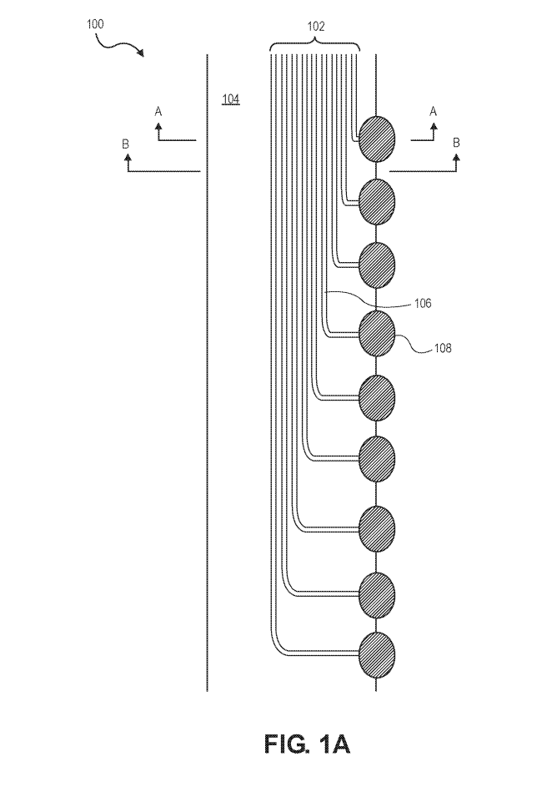
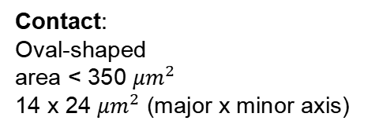
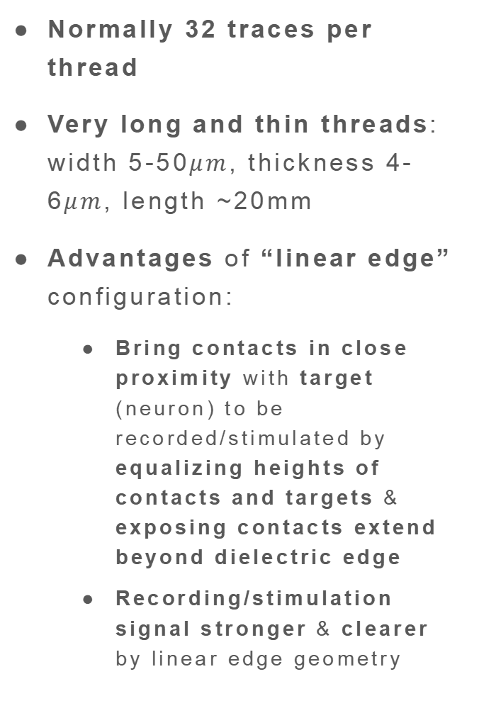
Schematic Top View of Electrode Thread in Linear Edge Configuration
Normally 32 traces per thread
Very long and thin threads: width 5-50$μm$, thickness 4-6$μm$, length ~20mm
Advantages of “linear edge” configuration:
Bring contacts in close proximity with target (neuron) to be recorded/stimulated by equalizing heights of contacts and targets & exposing contacts extend beyond dielectric edge
Recording/stimulation signal stronger & clearer by linear edge geometry
Wire traces formed from conductor (e.g., thin gold film)
wire traces
dielectric edge
Each trace
--> reference electrode ---> reference signal from fluid in tissue
dielectric base
trace
(e.g., polymide)
contact
Contact:
Oval-shaped
area < 350 ${μm}^{2}$
14 x 24 ${μm}^{2}$ (major x minor axis)
“linear edge”

Slide 6
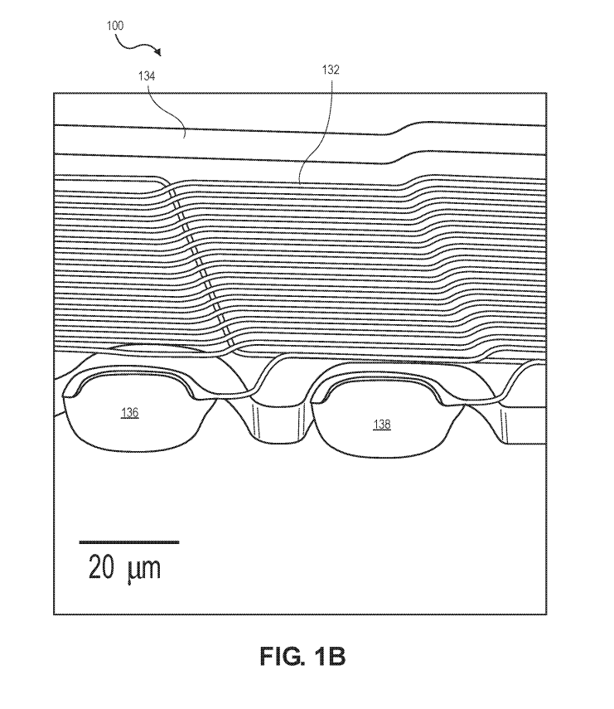
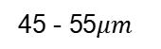
Detail View of Electrode Thread
Advantages of compact spacing and small electrode area:
More accurate recording/stimulation signals
Minimize tissue displacement in target
Allows surface modifications to lower impedance for electrophysiology via conductive polymers:
Poly-ethylenedioxythiophene doped with polystrene sulfonate (PEDOT:PSS)
imp = 36.97 +/- 4.68kΩ (n=257 electrodes)
Iridium oxide (IrOx)
imp = 56.46 +/- 7.10kΩ (n=588 electrodes)
Increase effective charge-carrying capacity of interface
Traces parallel to dielectric base
dielectric base
traces
creases following contour / modulations of width of base
electrode contacts
45 - 55$μm$

Slide 7
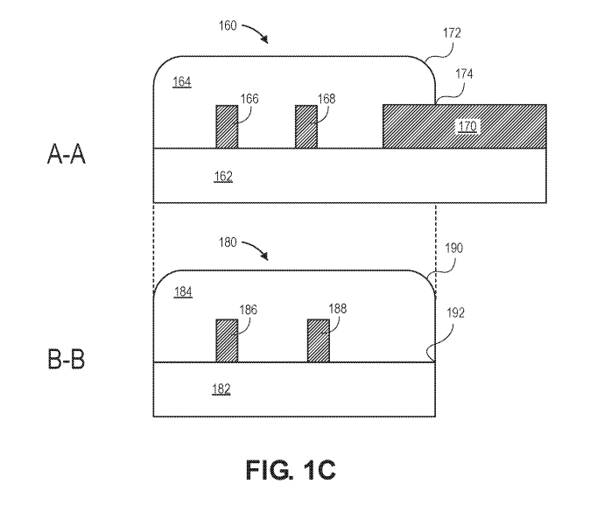
2 Cross-Section Views of Electrode Thread
edge
Partial dielectric cover (top):
Used as insulation between electrical traces
partial dielectric cover (top)
electrical traces
side
electrode contact
Electrode contact:
may be rectangular or oval
Biocompatible, compliant dielectric of electrode thread referred as “single dielectric”
dielectric base (bottom)
partial dielectric cover (top)
edge
A-A section:
Inside and bottom protrudes beyond top
electrical traces
side
dielectric base (bottom)
B-B section: Traces fully covered by top

Slide 8
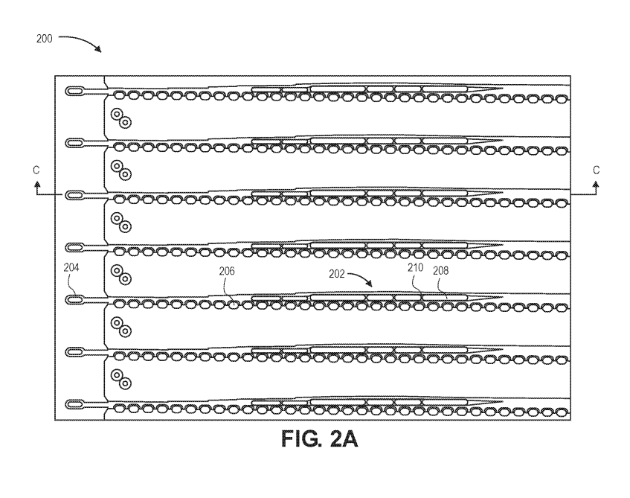
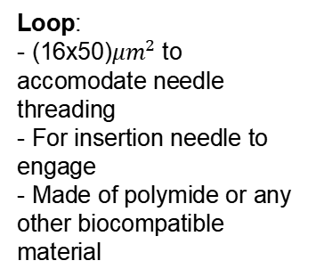
Top View of Multiple Electrode Threads in Linear Edge Configuration
Exposed portion of metal:
Electrical traces not covered by 2nd dielectric layer
Strip:
Partially covers exposed metal portions
2nd dielectric layer:
Partial dielectric cover
Normally 48 or 96 threads/electrode array
Each thread - 32 independent traces terminating in electrode contacts
Threads - arranged in pillbox-cartridge assembly (which positions with insertion needle in surgical field)
threads arranged in pillbox-cartridge assembly
loop
2nd dielectric
layer
thread
strip
exposed portion
Loop:
- (16x50)${μm}^{2}$ to accomodate needle threading
- For insertion needle to engage
- Made of polymide or any other biocompatible material

Slide 9
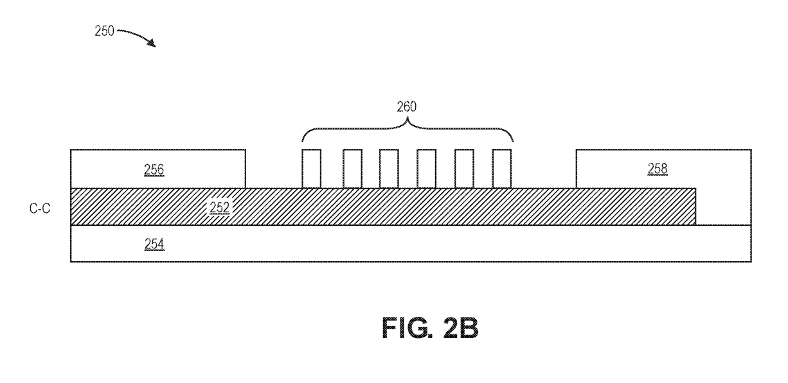
Lengthwise Cross-section View of 1 Electrode Thread
C-C section:
Top:
Partial cover - Partially covering strips with trace exposed - partial cover (with side)
partially covering strips
partial cover
partial cover incuding side
electrical trace
insulate right end of traces
to engagement feature / loop
dielectric base

Slide 10
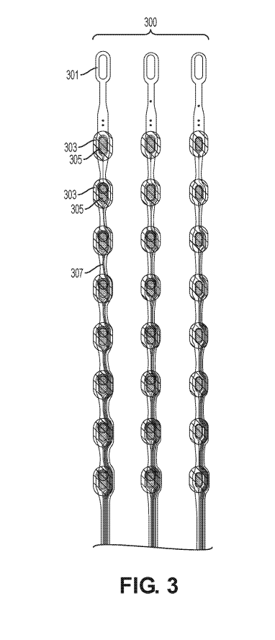
3 Linear Electrode Arrays
Openings:
- in support layer (parylene)
- may contain 8, 12 or more openings / active sites per thread
loop
Electrodes:
- configured to record/stimulate
- arranged towards end of probe so exposed metal is flush with target tissue for implantation
openings
electrodes
electrical trace
Electrical trace:
connects openings and electrodes to IC chip

Slide 11
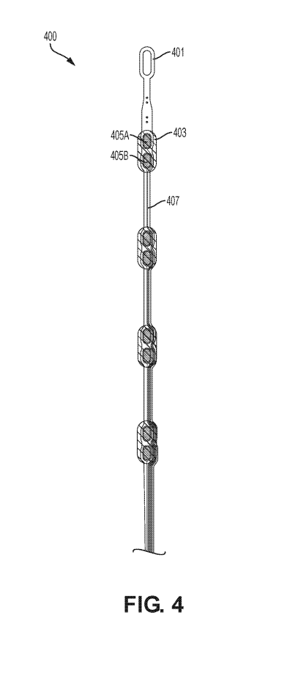
Linear Array - Stereotrode Configuration
loop
2 electrodes per group:
“Reference” measurement/stimulation
“Working” or actual measurement/stimulation
Difference of the 2 electrode measurements determine precision of measurement
2 electrodes record same activity (with relative position offset) - used for localization of recorded electrical activity
Can also have more than 2 electrodes (e.g.,“tetrode” = 4 electrodes per group)
group of 2 electrodes
opening
electrical traces

Slide 12
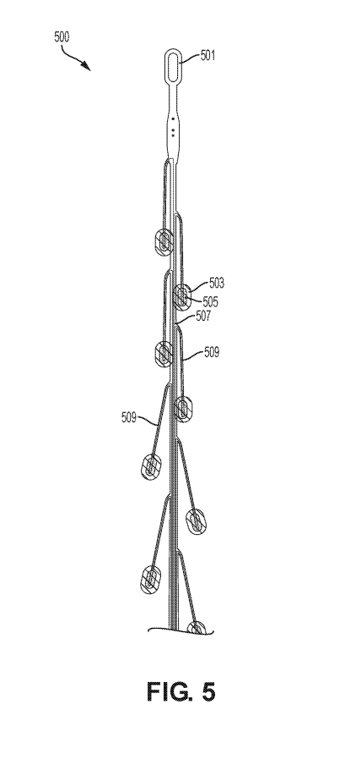
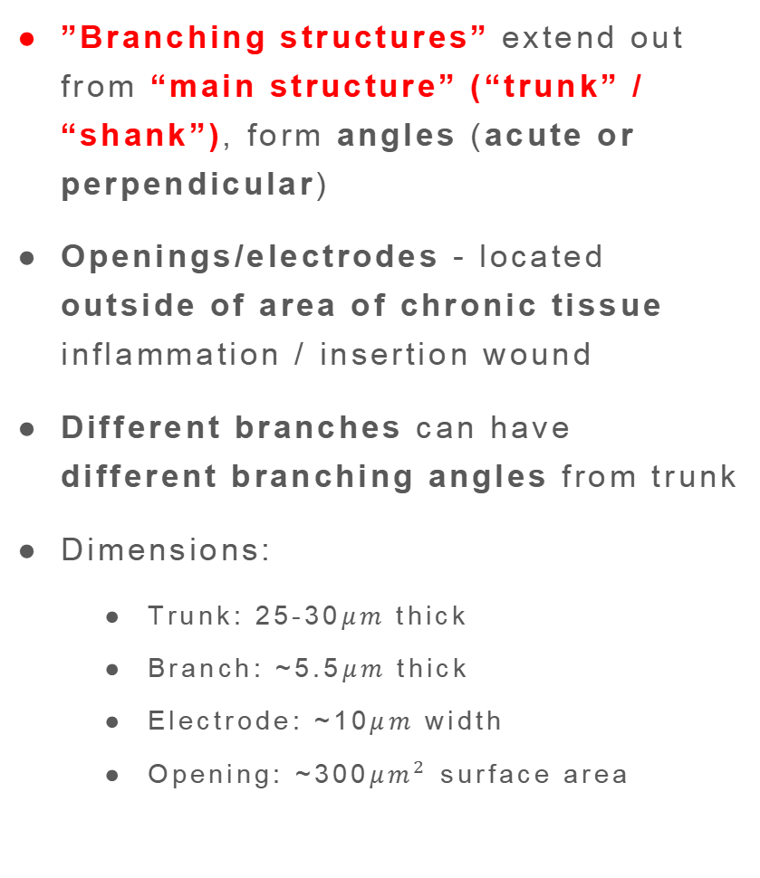
Electrode Array - Tree Configuration
Purpose/Advantages
Config Description
Conventional implantable devices - prone to chronic inflammation / acute immune response @ insertion site
Very small cross-sectional area for insertion into tissue with multiple electrodes to extend beyond site of insertion trauma to tissue (don’t let needle touch cranial hole edge!)
Reduce interference from insertion scar
loop
”Branching structures” extend out from “main structure” (“trunk” / “shank”), form angles (acute or perpendicular)
Openings/electrodes - located outside of area of chronic tissue inflammation / insertion wound
Different branches can have different branching angles from trunk
Dimensions:
Trunk: 25-30$μm$ thick
Branch: ~5.5$μm$ thick
Electrode: ~10$μm$ width
Opening: ~300${μm}^{2}$ surface area
opening
electrode
electrical trace
branching structure
angle can be acute or perpendicular
main structure or “trunk”

Slide 13
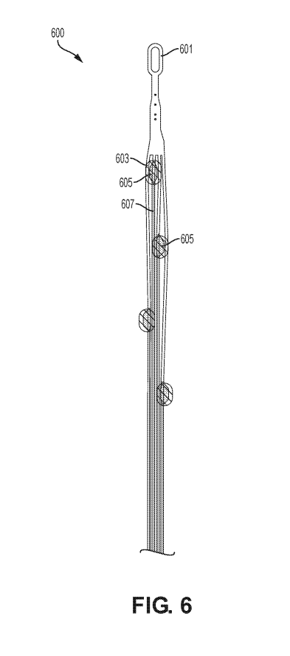
Electrode Array - Quadrapus Configuration
Purpose/Advantages
Config Description
Solves immune-response interference with electrodes’ functionality
Multiple thin, flexible electrodes extending beyond site of insertion over period of time
Surround target tissue & provide 3D recording/stimulation
Can dissipate mechanical strain (e.g., strain exerted on one individual strand reduces influence on other strands)
loop
4 openings shown (“quadrapus”), each located with separate thread or strand (“tentacle”)
The 4 threads can be joined at loop
Threads can wrap around needle during implantation, splay (expand) upon removal of needle
8 threads = “octopus”
opening
electrical trace
electrode

Slide 14
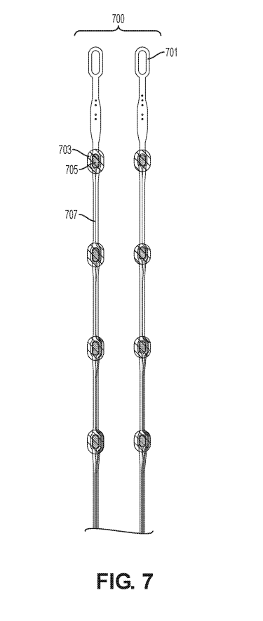
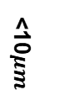
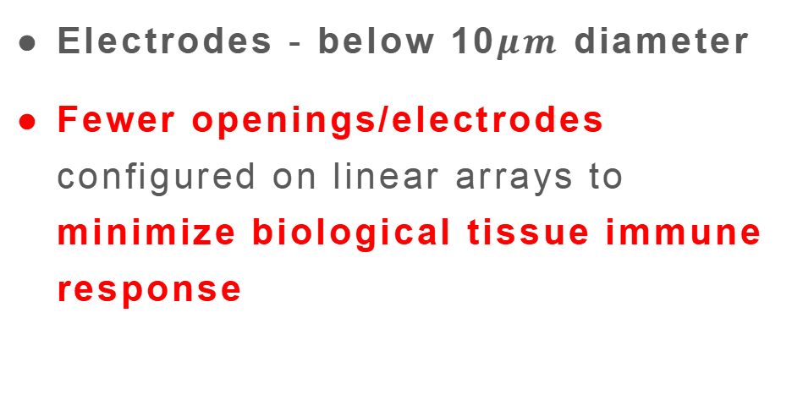
2 Linear Arrays - Minimal-Size Configuration
Purpose/Advantages
Config Description
Minimal size = minimize immune response of target biological tissue upon implantation
loop
Electrodes - below 10$μm$ diameter
Fewer openings/electrodes configured on linear arrays to minimize biological tissue immune response
opening
electrode
electrical trace
<10$μm$

Slide 15
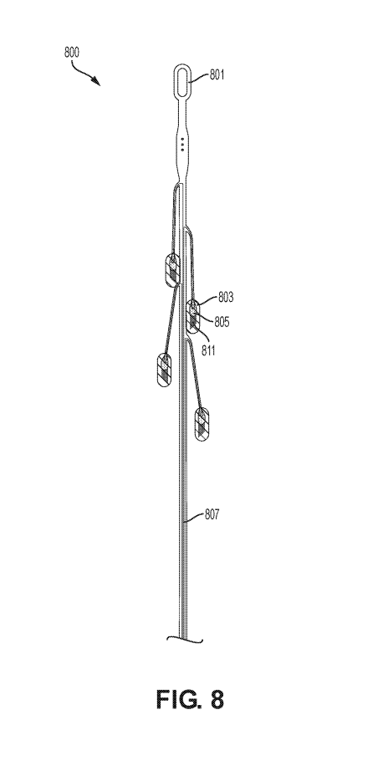
Electrode Array with Projections
loop
opening
electrode
projection
(“finger”)
Projection (“finger”):
Metallic
Made of platinum, gold, iridium, etc.
Sized in 500-1000nm
Extend into tissue for recording
Nonplanar to electrode array - used for 3D recording/stimulation
electrical trace

Slide 16
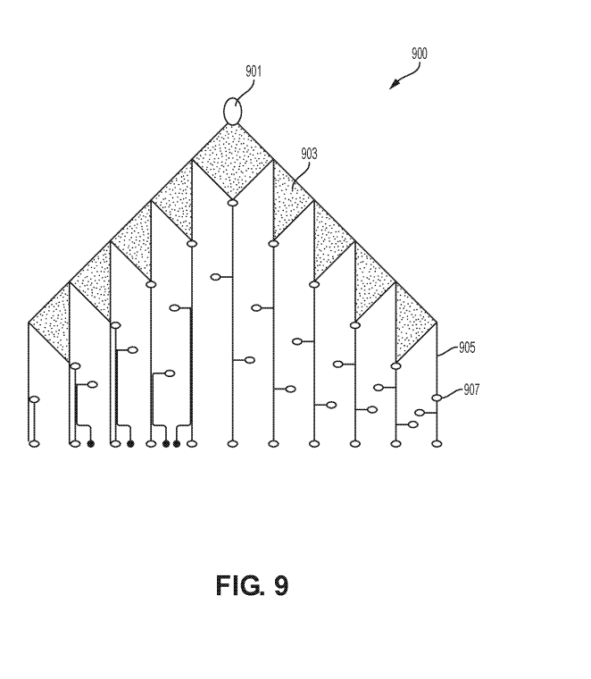

Electrode Array - Scaffold Configuration
Purpose/Advantages
Config Description
Complex, porous geometry for flexible electrode implantation
Extended structure - compacted to fit within small insertion hole
Used for flexible folding/unfolding during and after implantation
loop / engagement feature
Combines aspects from tree & quadrapus structure
Scaffolding:
Connect to about 3 traces, each trace 500-1000nm long
Made of polymide (or other biocompatible material)
30+ electrodes in single needle insertion
Electrode array unfolds over time as cells grow into insertion area and repair wound
scaffolding
electrical trace
500-1000nm
electrode
6$μm$

Slide 17
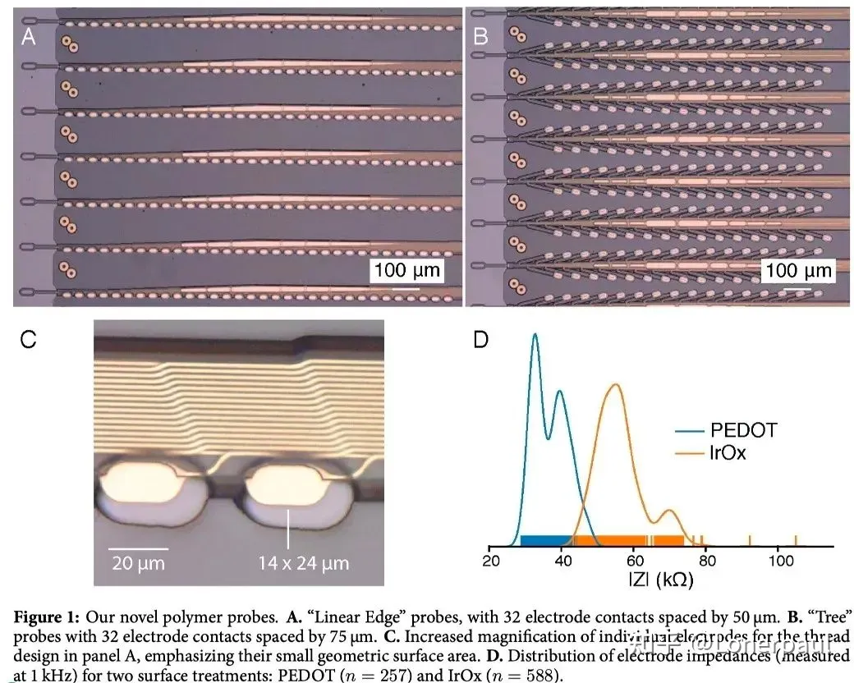
Source: https://zhuanlan.zhihu.com/p/574574159

Slide 18
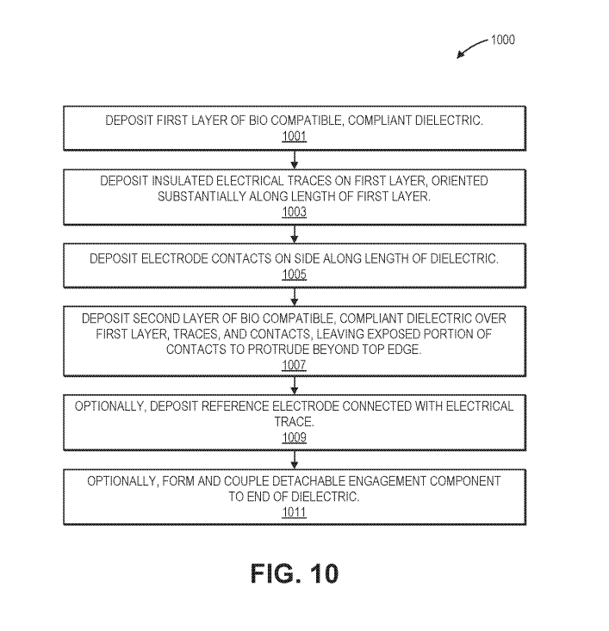
Fabricate Bio-implantable compliant electrode

Slide 19
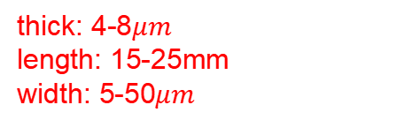
Step 1:
A-A
dielectric base
(1st layer)
dielectric base
(1st layer)
thick: 4-8$μm$
length: 15-25mm
width: 5-50$μm$
B-B
dielectric base
(1st layer)
Top view
Cross-sectional view

Slide 20
Step 2:
traces (at least 20)
traces
A-A
dielectric base
(1st layer)
traces
B-B
dielectric base
(1st layer)
dielectric base
(1st layer)
Top view
Cross-sectional view

Slide 21
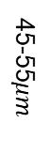
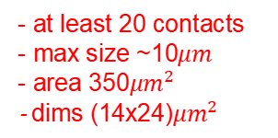
Step 3:
traces
traces
contact
(with working electrode)
A-A
dielectric base
(1st layer)
45-55$μm$
contact
(with working electrode)
traces
B-B
dielectric base
(1st layer)
- at least 20 contacts
- max size ~10$μm$
- area 350${μm}^{2}$
- dims (14x24)${μm}^{2}$
dielectric base
(1st layer)
Top view
Cross-sectional view

Slide 22
Step 4:
traces
partial dielectric cover (2nd layer)
traces
contact
A-A
dielectric base
(1st layer)
contact
(with working electrode)
partial dielectric cover (2nd layer)
traces
B-B
dielectric base
(1st layer)
partial dielectric cover (2nd layer)
Top view
Cross-sectional view

Slide 23
Step 5:
Purpose: to reduce noise and increase accuracy
traces
partial dielectric cover (2nd layer)
traces
contact
reference electrode
A-A
dielectric base
(1st layer)
contact
(with working electrode)
partial dielectric cover (2nd layer)
traces
B-B
dielectric base
(1st layer)
partial dielectric cover (2nd layer)
Top view
Cross-sectional view

Slide 24
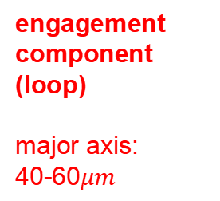
Step 6:
engagement component (loop)
major axis:
40-60$μm$
partial dielectric cover (2nd layer)
traces
contact
reference electrode
A-A
dielectric base
(1st layer)
trace
contact
(with working electrode)
partial dielectric cover (2nd layer)
traces
B-B
dielectric base
(1st layer)
partial dielectric cover (2nd layer)
Top view
Cross-sectional view

Slide 25
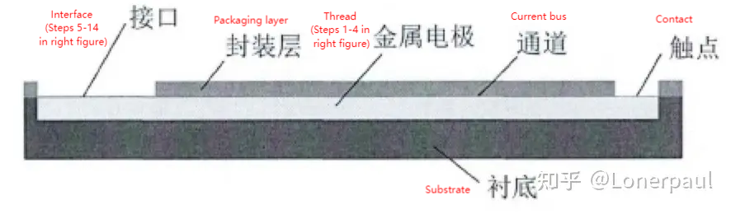
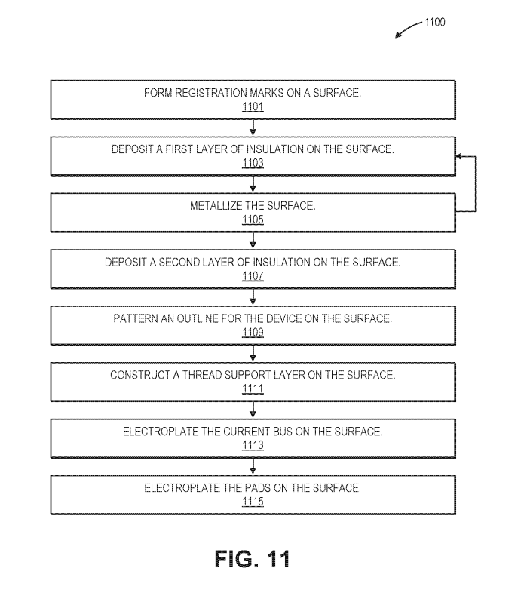
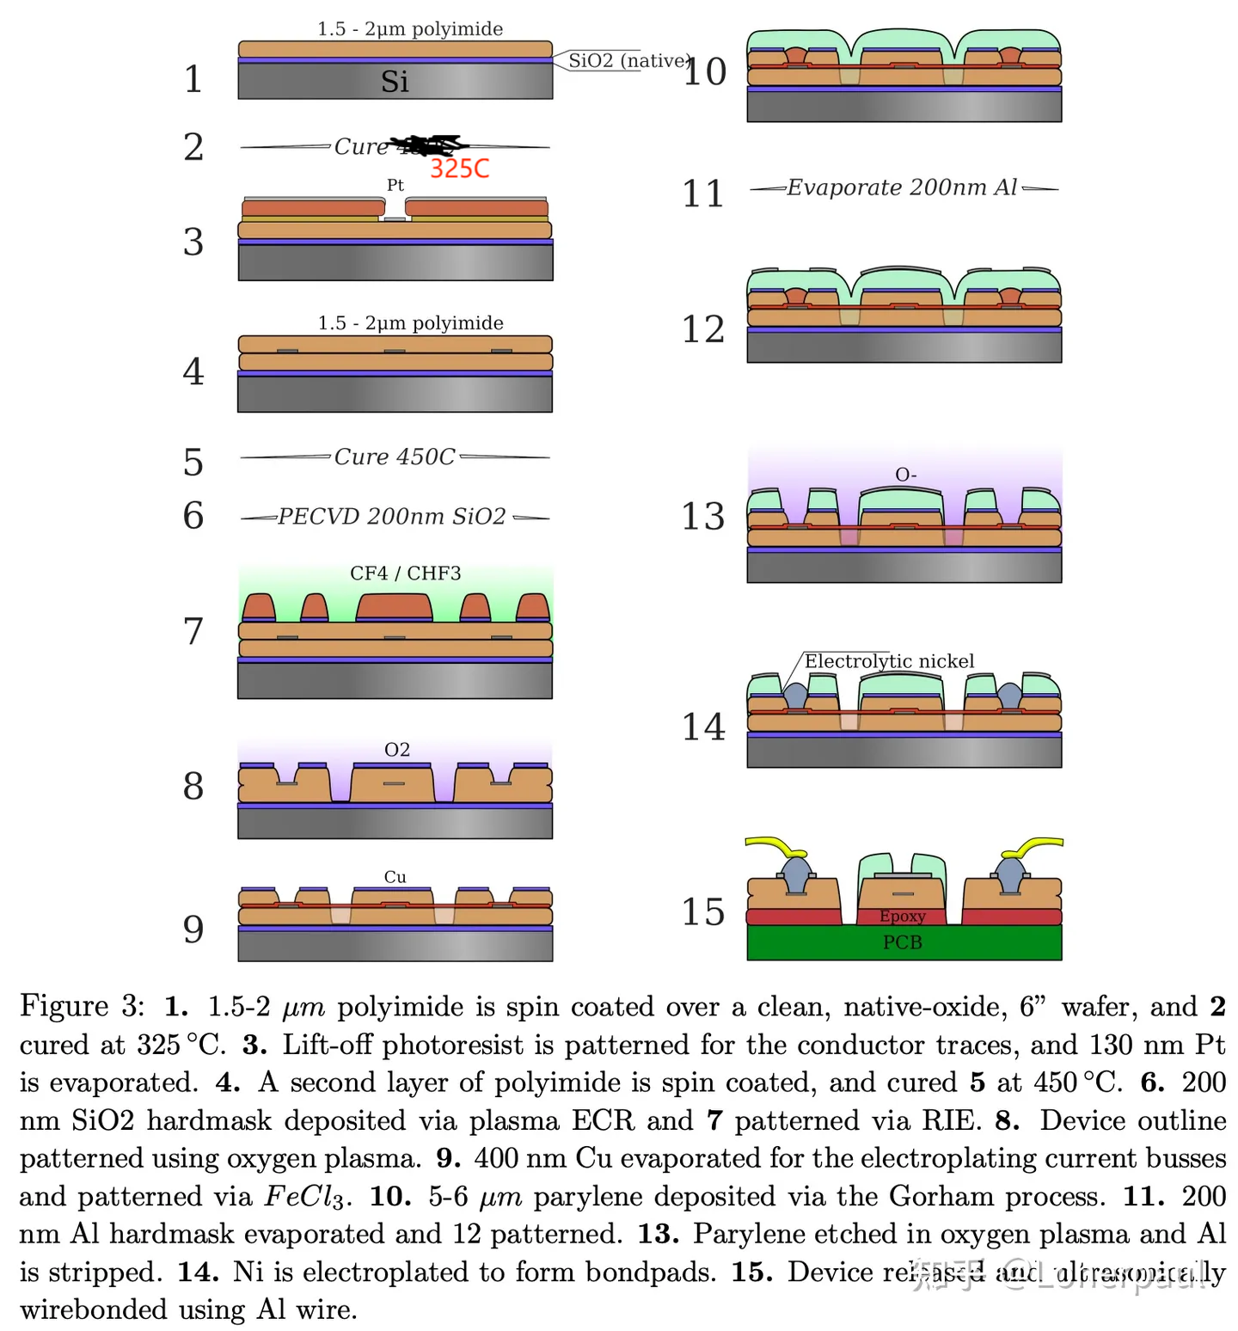
Fabricate Electrode Arrays
Source: https://www.zhihu.com/question/418085084/answer/2726997604

Slide 26
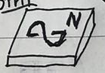
Step 1:
registration mark

Slide 27
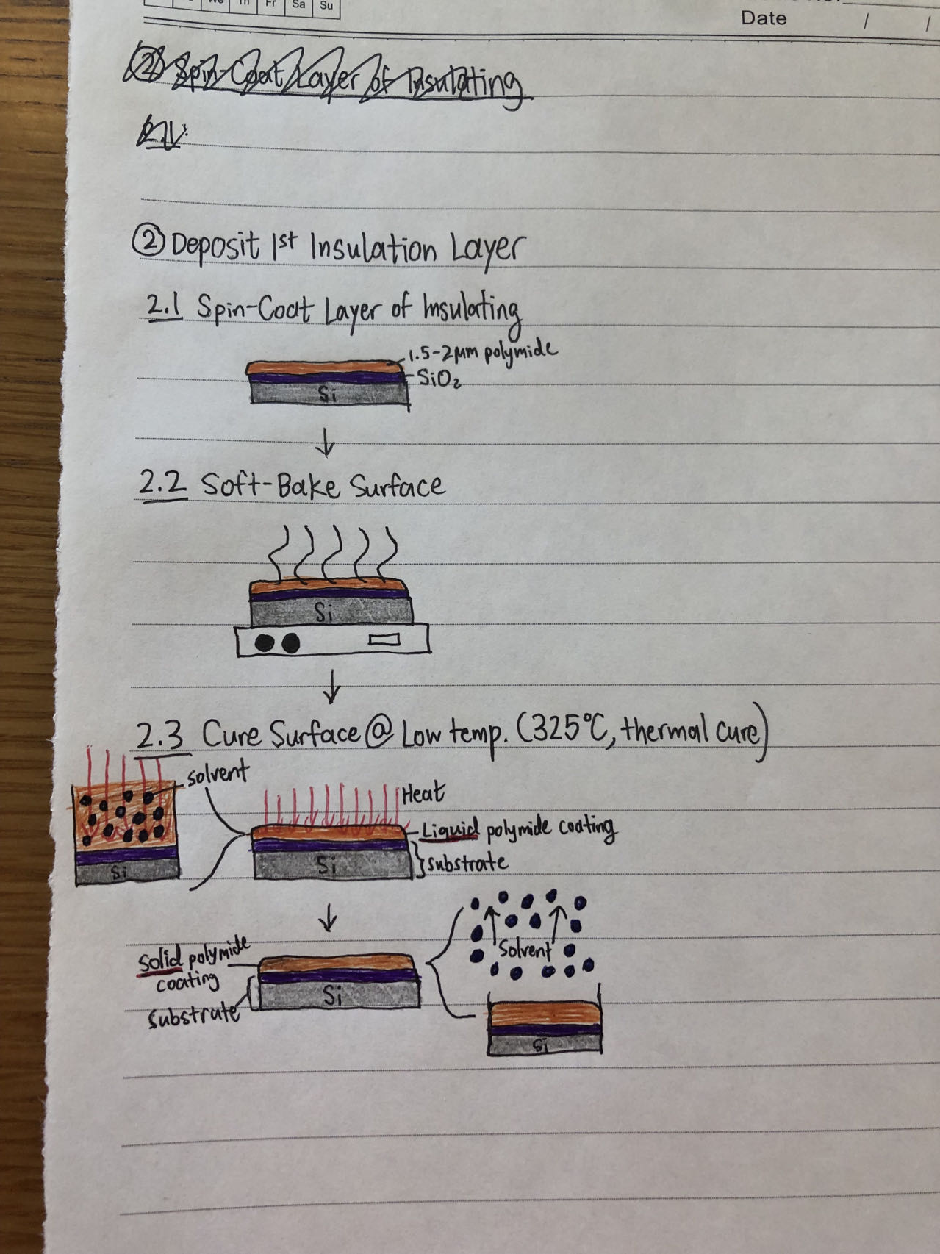
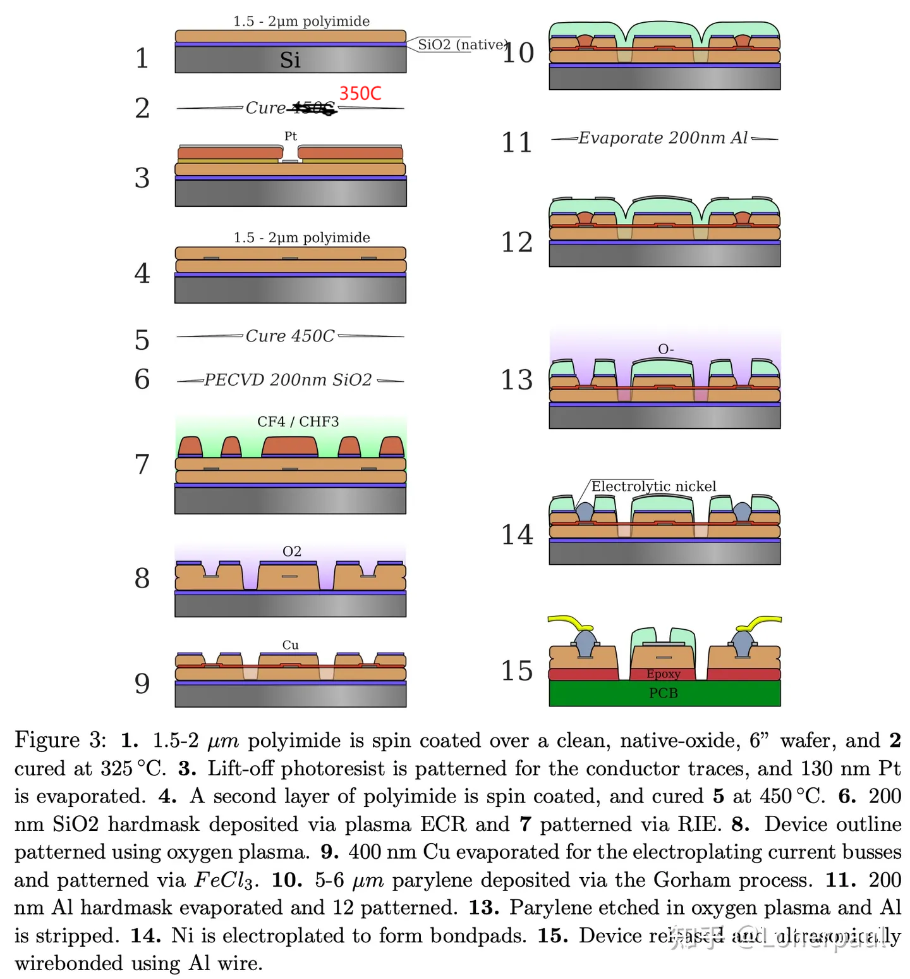
Step 2:

Slide 28
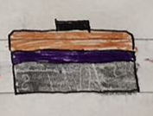
Step 3:
Note: steps 2 and 3 (insulation layer + metallizing) can be repeated as many times as needed
metal lift-off (evaporation)
metal for conductor traces

Slide 29
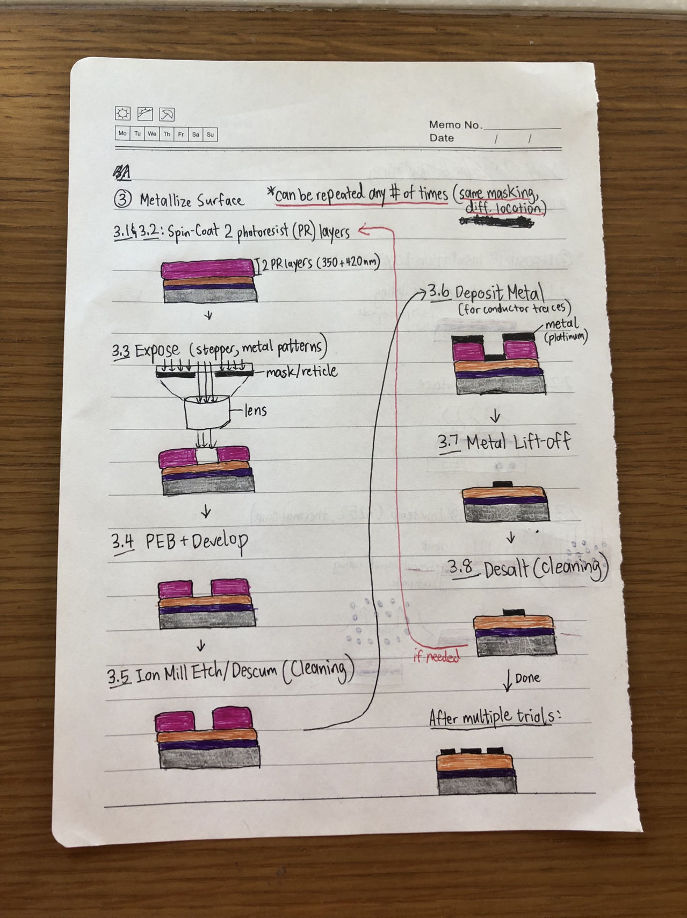
Step 3:
Note: steps 2 and 3 (insulation layer + metallizing) can be repeated as many times as needed
metal (e.g., platinum)

Slide 30
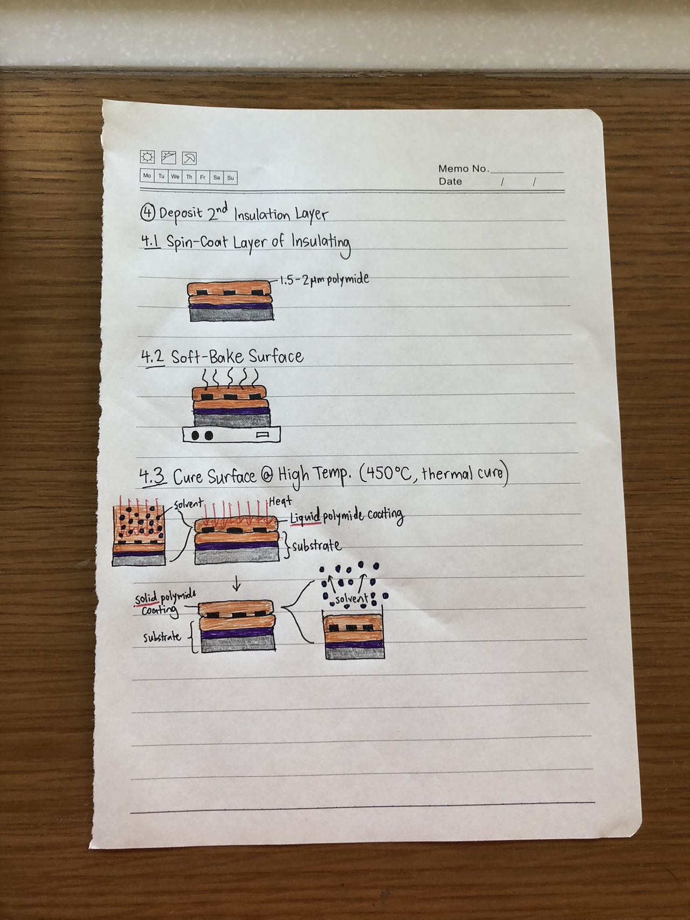
Step 4:

Slide 31
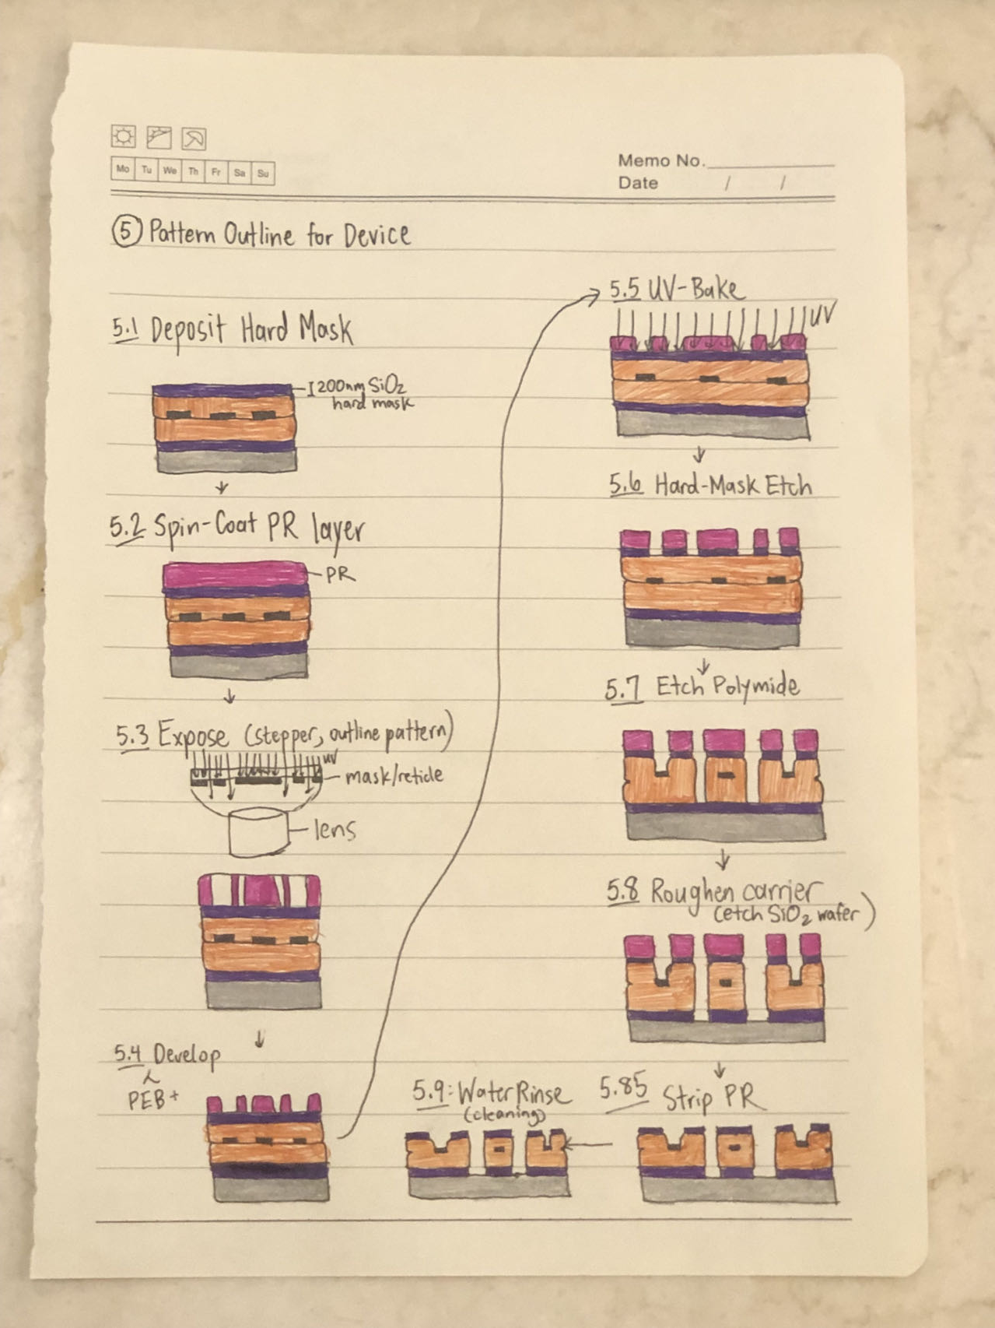
Step 5:

Slide 32
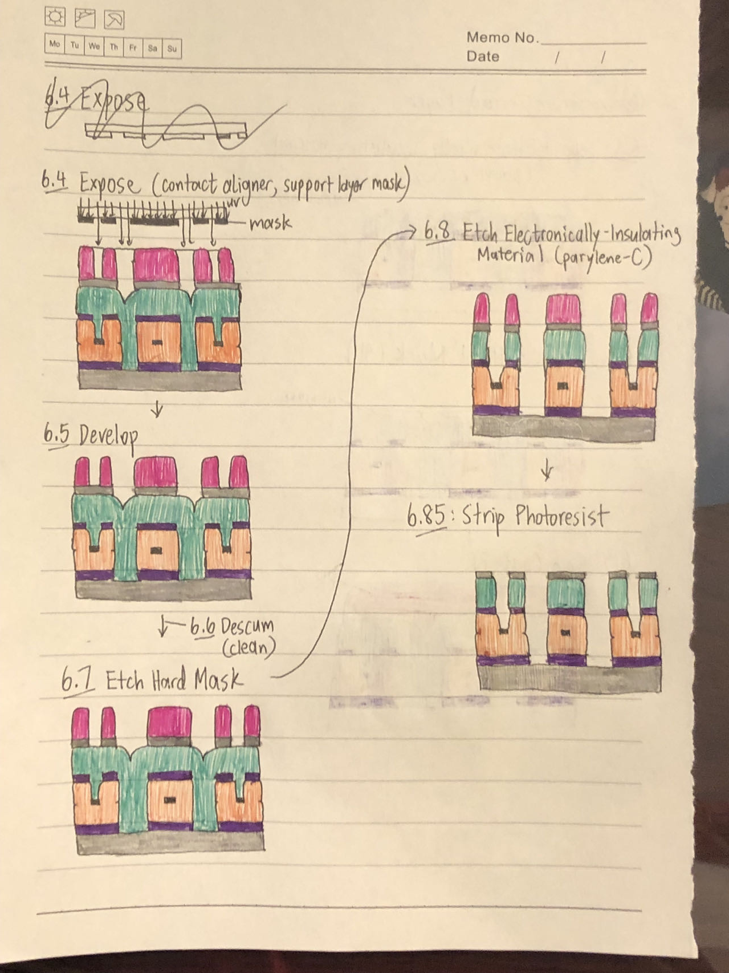
Step 6:
parylene-C
(thread support layer)
parylene-C
(thread support layer)

Slide 33
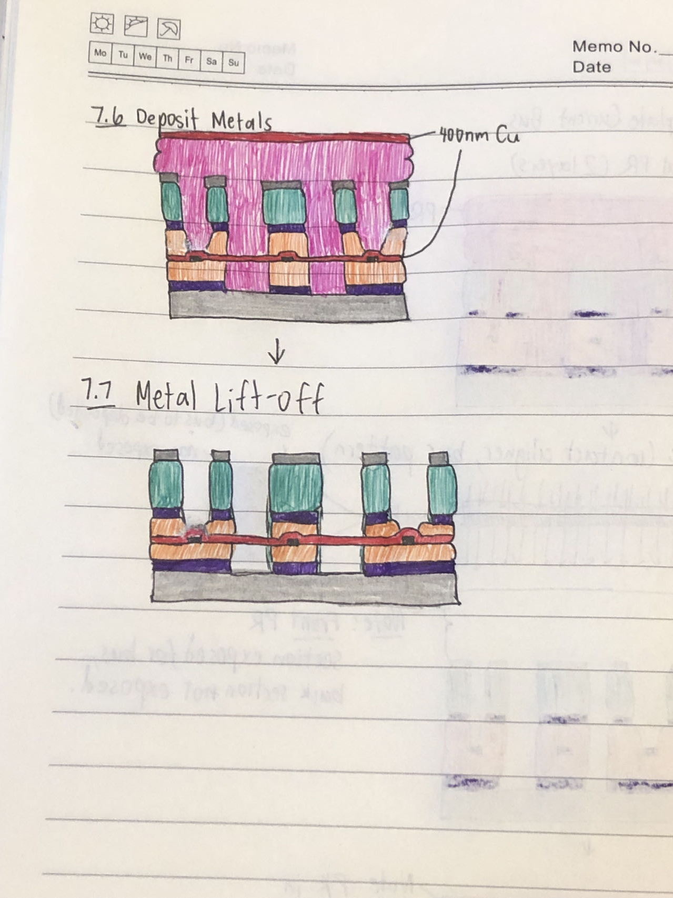
Step 7:
current bus

Slide 34
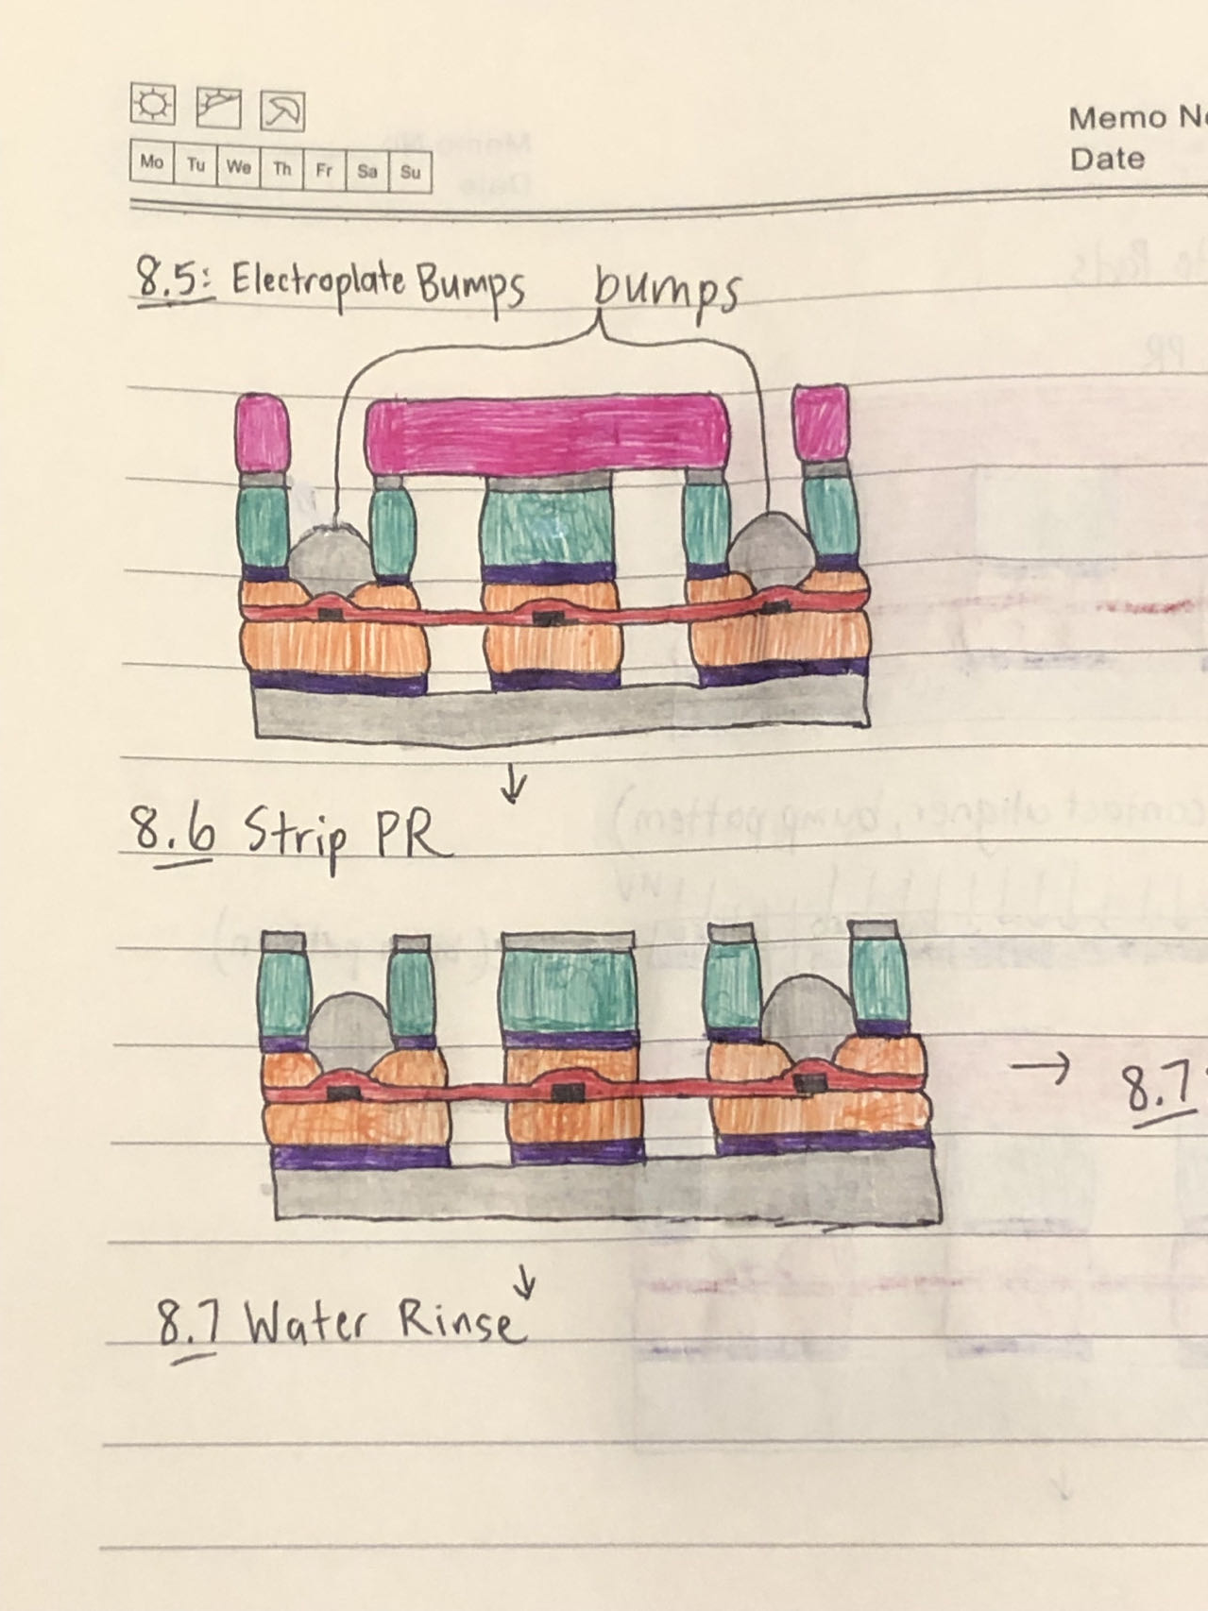
Step 8:
electrolytic nickel pad

Slide 35
Not shown: Device Release + Ultrasonic Wire-bonding

Slide 36
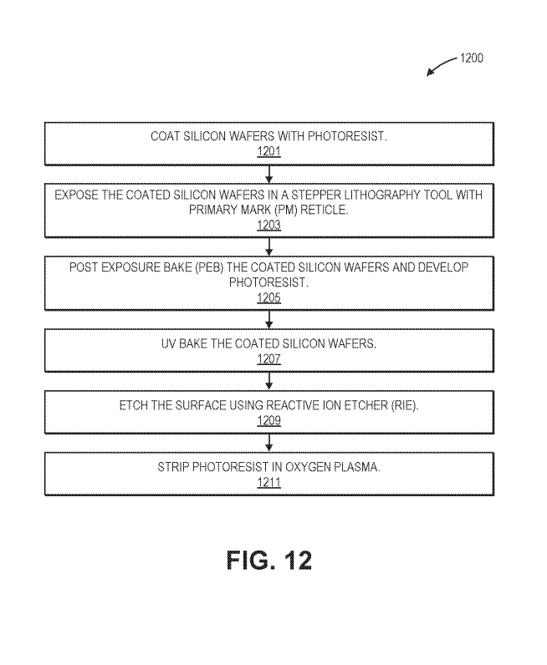
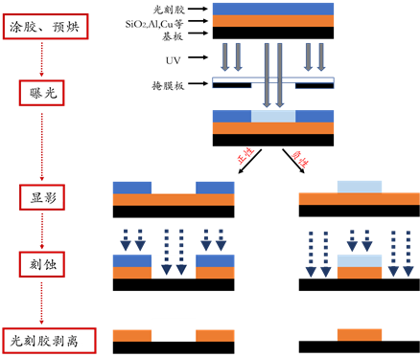
1. Form Registration Marks on Surface
Registration marks - allow layer-to-layer alignment @ resolution of ~40nm (higher resolution features)
Image source： http://www.yxkxyghx.org/CN/abstract/html/20160201.htm

Slide 37
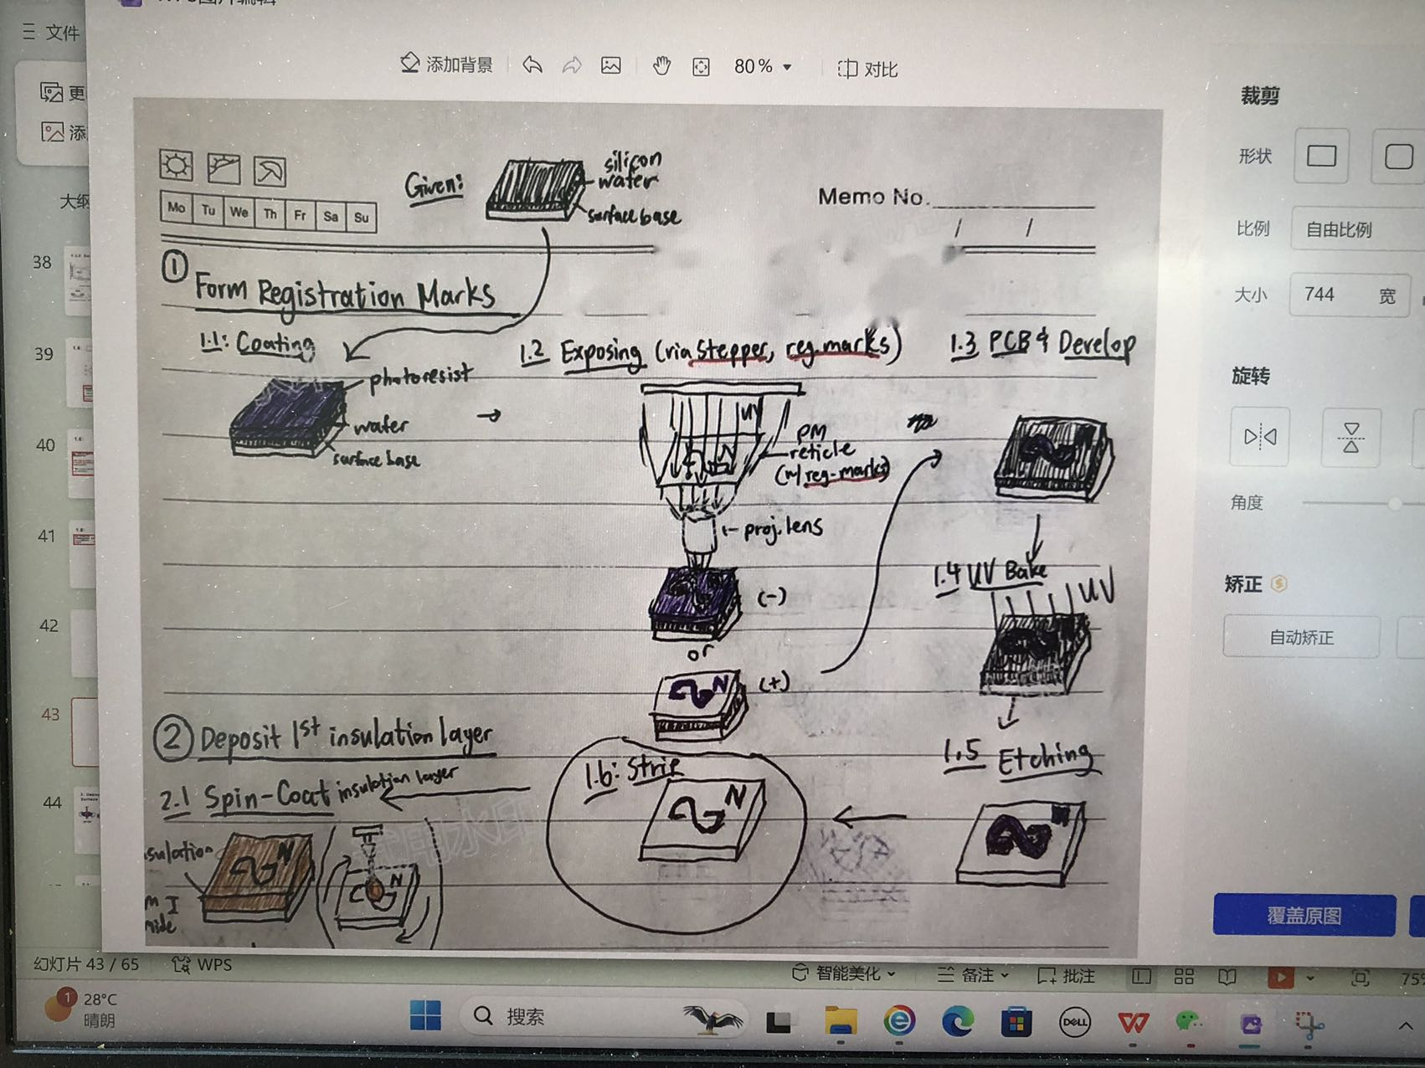
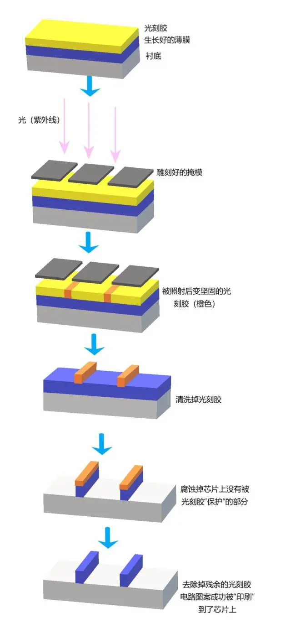
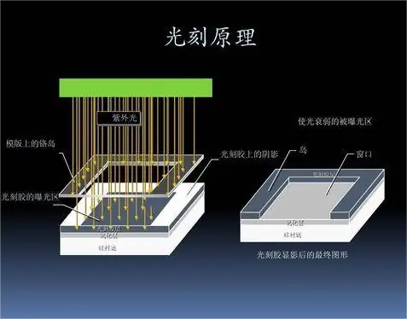
1.1:
Photoresist - use UV light to coat a layer of silicon (“silicon wafer”)

Slide 38
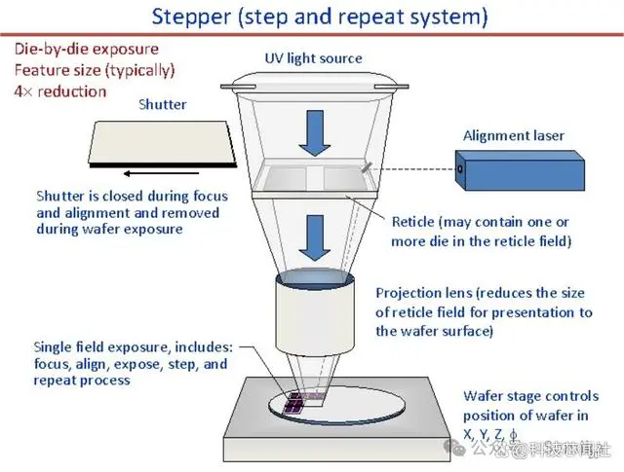
1.2:
Stepper Lithography:
- Used for designing IC chips
- Small silicon wafer has MILLIONS of micro circuit components with high precision (nm)
- Drawback: very SLOW due to gradual movement
Image Source: https://baijiahao.baidu.com/s?id=1794853680869316211&wfr=spider&for=pc

Slide 39
1.3:

Slide 40
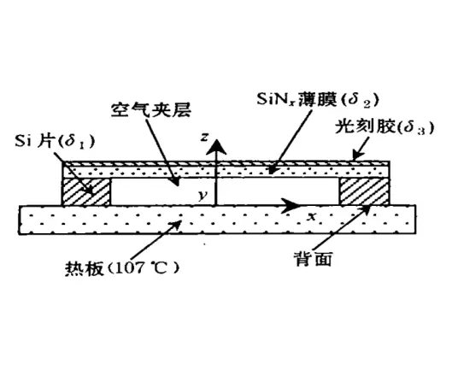
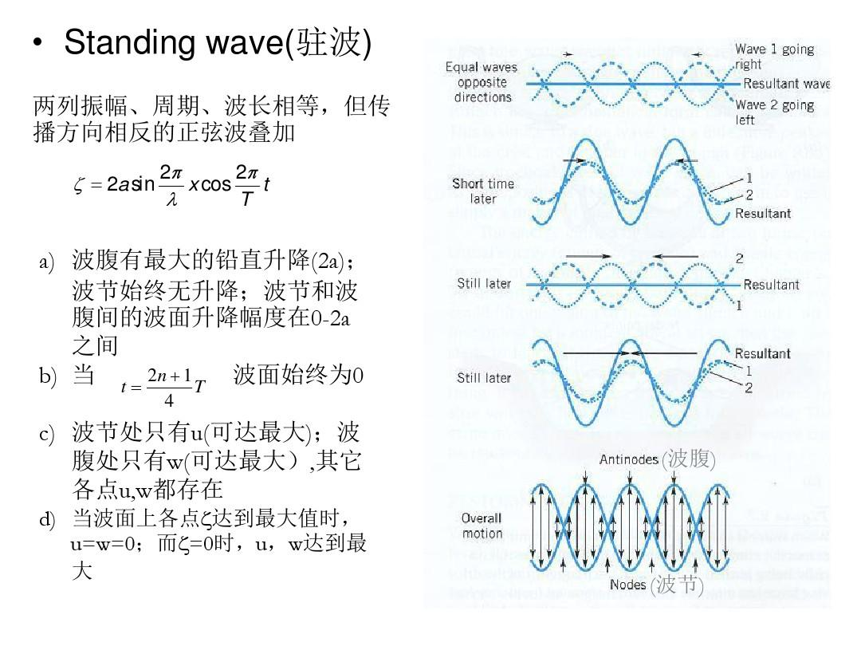
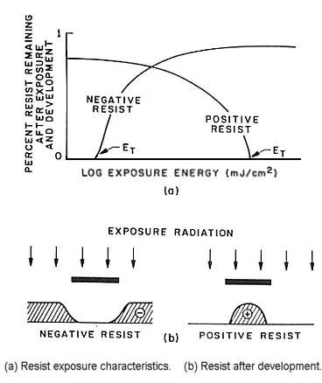
1.3.1: Post-Exposure Bake Coated Silicon Wafers
Why baking after exposure?
Problem: After exposure, standing waves occur at borders of exposed and non-exposed regions (gray areas), which causes degrading resolution of image features.
Solution: Baking prevents standing waves from occuring, resulting in higher resolution (more defined) regions.
gray areas between regions

Slide 41
1.3.2: Develop Photoresist
2 types of photoresists: Positive - Photoresist forms on unexposed (masked) regions
Negative - Photoresist forms on exposed regions

Slide 42
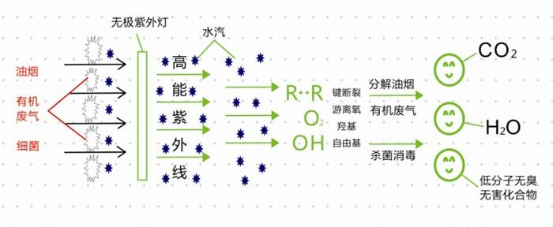
1.4:
UV Baking:
- Harden the photoresist layer
- Kill bacteria (sterilize wafers / photoresist) via UV rays to form cations

Slide 43
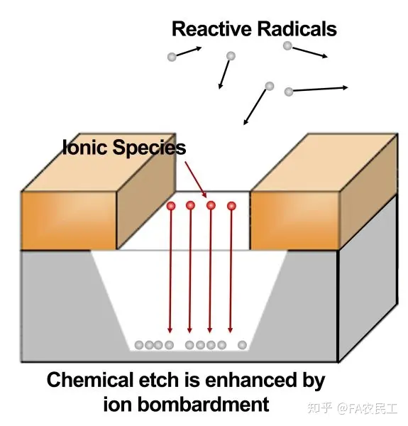
1.5:
RIE: Corrode regions not protected by photoresist
Pros: High precision & clarity, high resolution, fast etching speed, etching depth adjustable
Cons: Complex manufacturing, high cost, high skill bar
Image source: https://zhuanlan.zhihu.com/p/164829377

Slide 44
1.6:
Aka: Get rid of the remaining photoresist on the protected regions

Slide 46
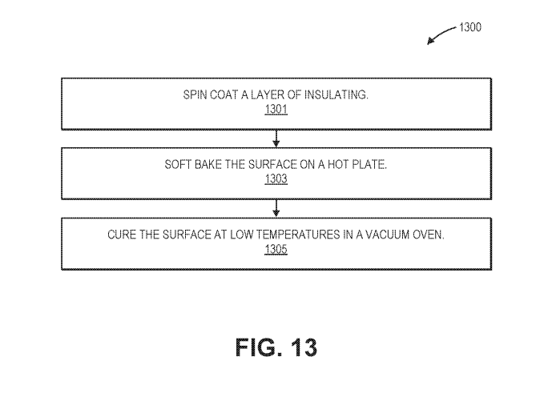


2. Deposit First Layer of Insulation onto Surface
Spin-coat
Soft-Bake
Thermal-cure

Slide 47

2.1:
Main advantage of spin coating: Provide a dense, even layer of coating on surface
centrifugal force

Slide 48

2.2:
Soft-Baking
(aka Pre-Baking)
Soft-Baking (aka Pre-Baking):
Allow solvents inside photoresist film to slowly escape to dry the photoresist film.
Purpose:
- Improve polymide wafer coverage
- Remove solvents from photoresist
- Increase adhesion
- Reduce surface tension within photoresist from spin-coating
- Prevent photoresist from being stuck to surface (keep surface clean)

Slide 49
2.3:
“Low temperatures”： 325C, use thermal curing

Slide 50
Curing Surfaces: UV-Curing vs Thermal-Curing
Photo/UV-Curing:
- Absorb light energy using UV light absorbers (photo initiator/mask)
- Excite it to produce highly active free ions
- Trigger reactions between monomer molicules to form polymer compounds
- Used in electronics, coatings, plastics (small-scale manufacturing)
Pros:
- FAST curing speed
- Efficient, eco-friendly (Solvent-free / Volatile-free)
- Easy to automate
- Materials easy to control
- Transparent surface after curing
- Low curing temperature
Cons:
- Material oxidation - discoloration/aging
- Insufficient polishing - less smooth surface, accumulation of plaque
- Polymer shrinkage - damage to edge sealing, micro-leakage
Thermal Curing/Drying:
- Chemical reaction between epoxy + curing agents under heating forms 3D compounds
Pros:
- High curing degree
- Corrosion-durable
- High precision
- Complete curing reaction
- Stable performance
- Used in electrical, automotive, aviation, construction fields
(small AND large-scale manufacturing)
Cons:
- SLOW curing speed
- Non-eco-friendly - Additional solvents / gases REQUIRED for heating & controlling gases / volatile substances
- Materials not flexible
- High cost
Rule of thumb:
Use UV-curing for < 150C or less
Otherwise use thermal curing

Slide 52

3. Metallize Surface
metal lift-off (evaporation)
Note: Can be repeated multiple times (same mask pattern can be applied at different locations)

Slide 53
3.1 + 3.2:

Slide 54
3.3:

Slide 55
3.4:

Slide 56
3.5:

Slide 57
3.6:
metal deposited

Slide 58
3.7:
metal lift-off (evaporation)

Slide 59
3.8:

Slide 60
After repeating step 3 multiple times:

Slide 62

4. Deposit 2nd Layer of Insulation onto Surface
Spin-coat
Soft-Bake
Thermal-cure

Slide 63
4.1:

Slide 64
4.2:

Slide 65
4.3:
“High temperatures”： 450C, use thermal curing/drying

Slide 67

5. Pattern Outline for Device on Surface

Slide 68
5.1:

Slide 69
5.2:

Slide 70
5.3:

Slide 71
5.4:

Slide 72
5.5:

Slide 73
5.6:

Slide 74
5.7:

Slide 75
5.8:

Slide 76
5.85: Strip Photoresist (not shown in patent)

Slide 77
5.9:

Slide 79

6. Constructing Thread Support Layer
parylene-C
(thread support layer)
Al hard mask (protects support layer)

Slide 80

6.1:

Slide 81
6.2:

Slide 82
6.3:

Slide 83

6.4:

Slide 84
6.5 + 6.6:

Slide 85
6.7:

Slide 86
6.8:

Slide 87
6.85: Strip Photoresist (not shown in patent)

Slide 89

7. Electroplate Current Bus onto Surface

Slide 90

7.1 + 7.2:

Slide 91
7.3:

Slide 92
7.4 + 7.5:

Slide 93
7.6:

Slide 94
7.7:

Slide 96

8. Electroplate pads onto Surface

Slide 97

8.1:

Slide 98
8.2:

Slide 99
8.3 + 8.4:

Slide 100
8.5:

Slide 101
8.6:

Slide 102
8.7:

Slide 104
Not shown: Device Release + Ultrasonic Wire-bonding
Front view of electrode (part to be implanted):
parylene-C
wire
metal contact
(to chip pins/adapter board pins)
Note: Green parylene stripped by machine before implantation

